Slide 1
Amateur Radio FM Satellite Communications
Scott, KA7FVV ka7fvv.net

Slide 2
Content of presentation
What do I need to work FM satellites?
How do I know what satellite to work?
What mode and frequencies do I use?
How do I know when they are over my head?
Making a contact!

Slide 3
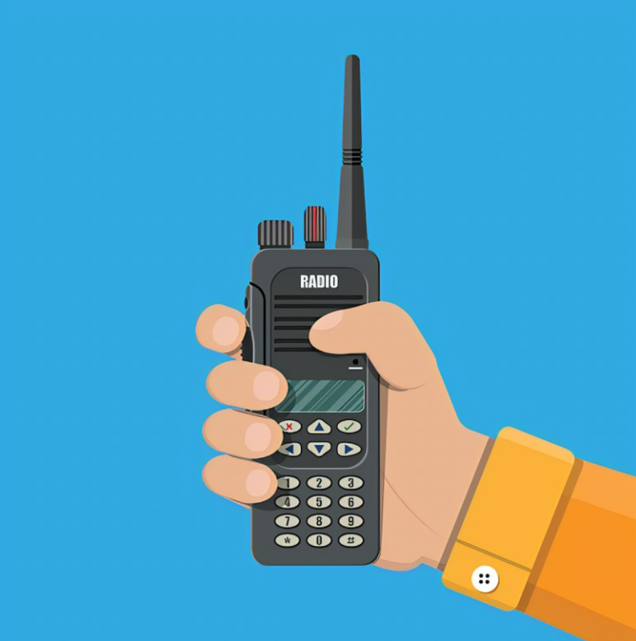
What do I need to work FM satellites?
Dualband Handheld (programmed appropriately)
Most handhelds you will be doing half duplex. Very few will do full duplex.
Icom IC-W32A, ID-51, ID-52, Baofeng UV-3R, UV-5R, Kenwood TH-D72 (FD), TH-74, Yaesu FT1D, FT-60, FT-65
Directional Antenna
Arrow Antenna
Elk Antenna
Satellites, modes and frequencies
Satellites to work
Modes: U/v or V/u
What frequencies
Satellite Tracking Program
Orbitron – PC, GoSatWatch – IOS,
ISS Detector Pro (add ons) – Android
Several Free Apps

Slide 4
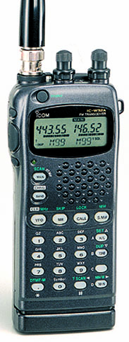
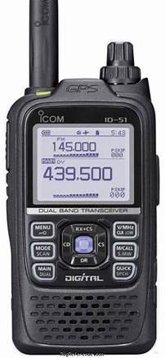
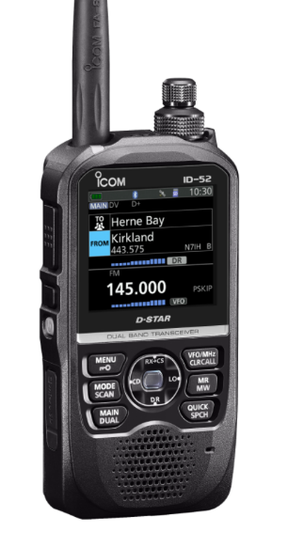
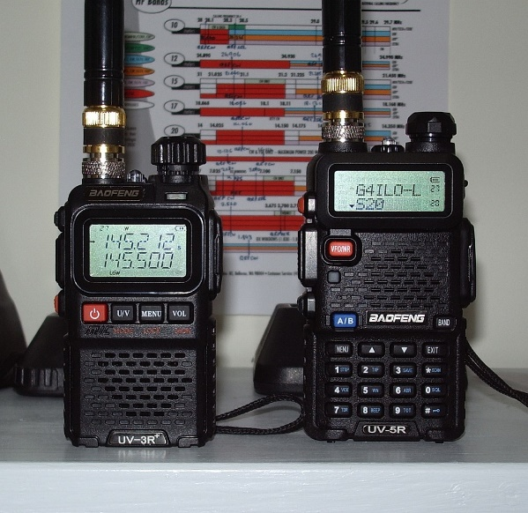
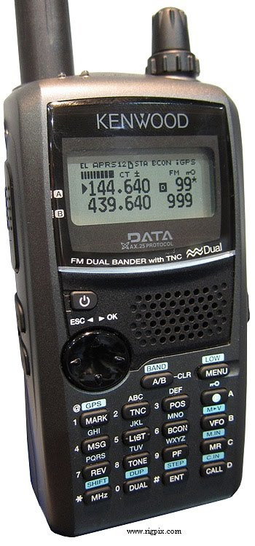
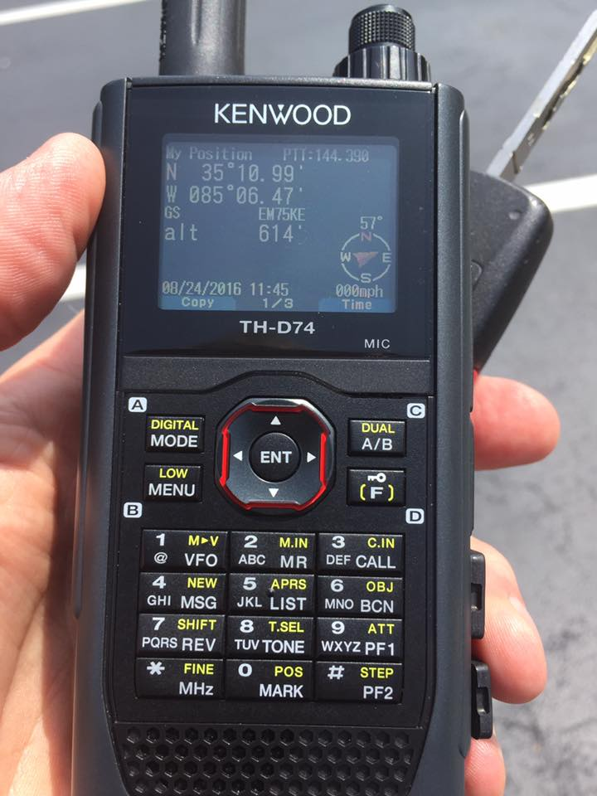
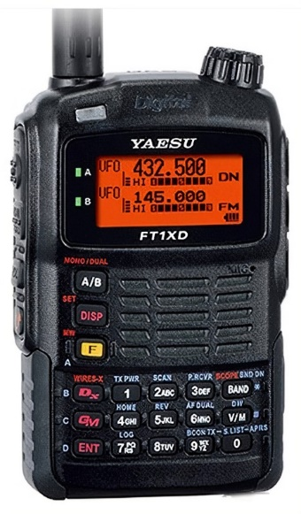
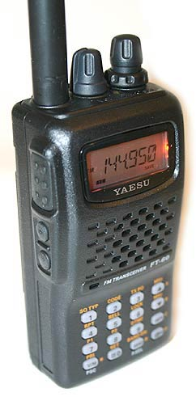
What do I need to work FM satellites?
Dualband Handheld (programmed appropriately)
Most handhelds you will be doing half duplex. Very few will do full duplex.
Icom IC-W32A, ID-51, ID-52, Baofeng UV-3R, UV-5R, Kenwood TH-D72 (FD), TH-74, Yaesu FT1D, FT-60, FT-65
The Icom IC-W32A was supposed to be full duplex but it never worked for me.
The Kenwood TH-D72 is full duplex. Need a headset. I use the light weight Heil headset.
The Baofeng and Yaesu handhelds have the advantage of being able to program the V/u or U/v split for the satellites into one memory.

Slide 5
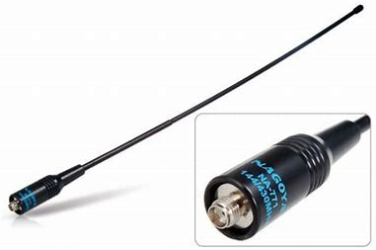
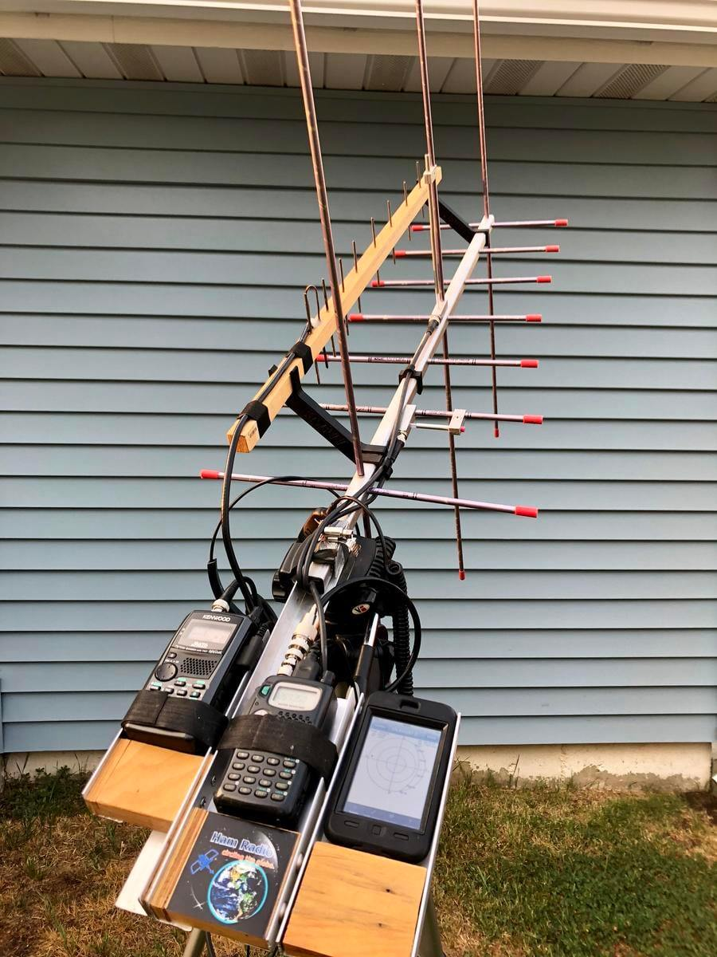
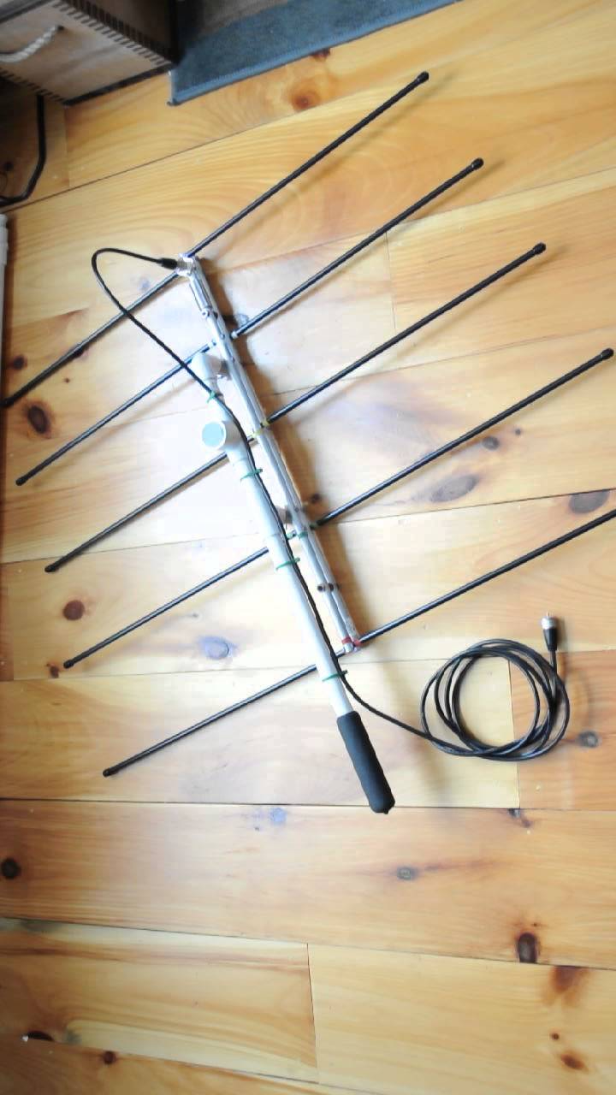
What do I need to work FM satellites?
Directional Antenna
Arrow Antenna
Comes in two models. The regular and Alaska.
Regular: 7 UHF/3 VHF elements.
Alaska: 10 UHF/4 VHF elements.
Can be ordered with a 10 watt built in duplexer.
Elk Antenna
5 element log periotic.
One coax, no duplexer needed.
Pros and Cons between the two.
Arrow is heavy. Tripod mounting is best.
Arrow breakdown and setup is slow.
Elk is lighter than the Arrow.
Elk Quick assembly and disassembly.
Elk is easy to travel with.

Slide 6
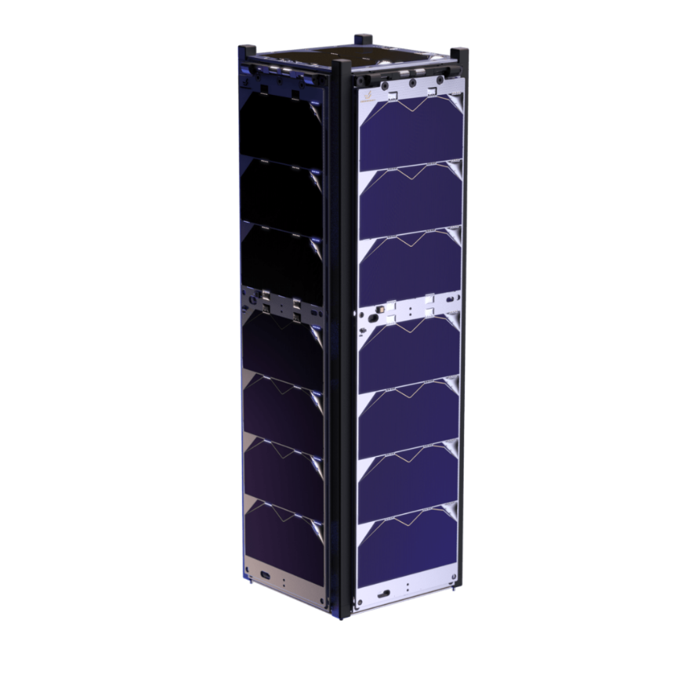
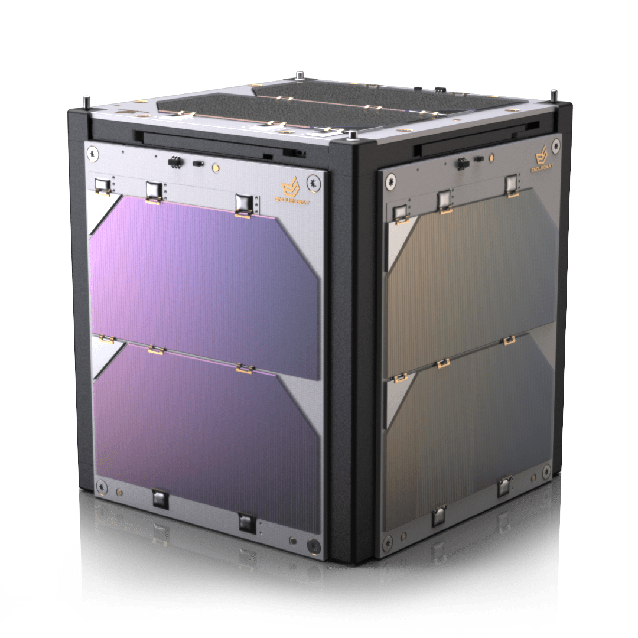
What do I need to work FM satellites?
Satellites, modes and frequencies
Satellites to work
Modes: U/v or V/u
What frequencies
AO-91, SO-50, AO-27, LilacSAT-2 (Intermittent), PO-101, ISS Repeater
These satellites use frequencies in the UHF and VHF amateur bands. There are sections specificly for satellite communications.
UHF - 435.000-438.000 MHz, VHF - 145.800-146.000 MHz
U/v – Transmit on UHF and listen on VHF
V/u – Transmit on VHF and listen on UHF
Cubesats are a satellite standard 4”x4” or 10 cm x 10 cm.
This is known as a 1U cubesat.

Slide 7
What do I need to work FM satellites?
Satellites Frequencies AMSAT – The Radio Amateur Satellite Corporation OSCAR – Orbiting Satellite Carrying Amateur Radio AO-91, SO-50, AO-27, LilacSAT-2 (Intermittent), PO-101, ISS Repeater
Amsat-Oscar 91 - AO-91 (Fox-1B) Daylight passes LilacSat-2 (CAS-3H) Intemittant
Mode U/v FM Transponder at 400 mw Mode V/u FM Transponder
UHF Uplink: 435.250 MHz FM - 67.0 hz tone VHF Uplink: 144.350 MHz FM VHF Downlink: 145.960 MHz FM UHF Downlink: 437.200 MHz FM
SO-50 (Saudisat 1C) 19 years, Dec 20, 2002 PO-101 (Diawata-2)
Mode V/u FM Transponder at 250 mw Mode U/v Transponder
VHF Uplink: 145.850 MHz FM – 67.0 hz tone UHF Uplink: 437.500 MHz FM – 141.3 hz tone
UHF Downlink: 436.795 MHz FM VHF Downlink: 145.900 MHz FM
AO-27 (Eyesat-1) International Space Station (ISS) Repeater
Mode V/u FM Transponder Mode V/u Repeater
VHF Uplink: 145.850 MHz FM VHF Uplink: 145.990 MHz FM – 67.0 hz tone
UHF Downlink: 436.795 MHz FM UHF Downlink: 437.800 MHz FM
ISS APRS ISS VHF Voice / Downlink is Rx for SSTV Events
145.825 MHz FM VHF Uplink: 144.490 MHz FM (-1.31 MHz split)
ARISS or RS0ISS VHF Downlink: 145.800 MHz FM

Slide 8
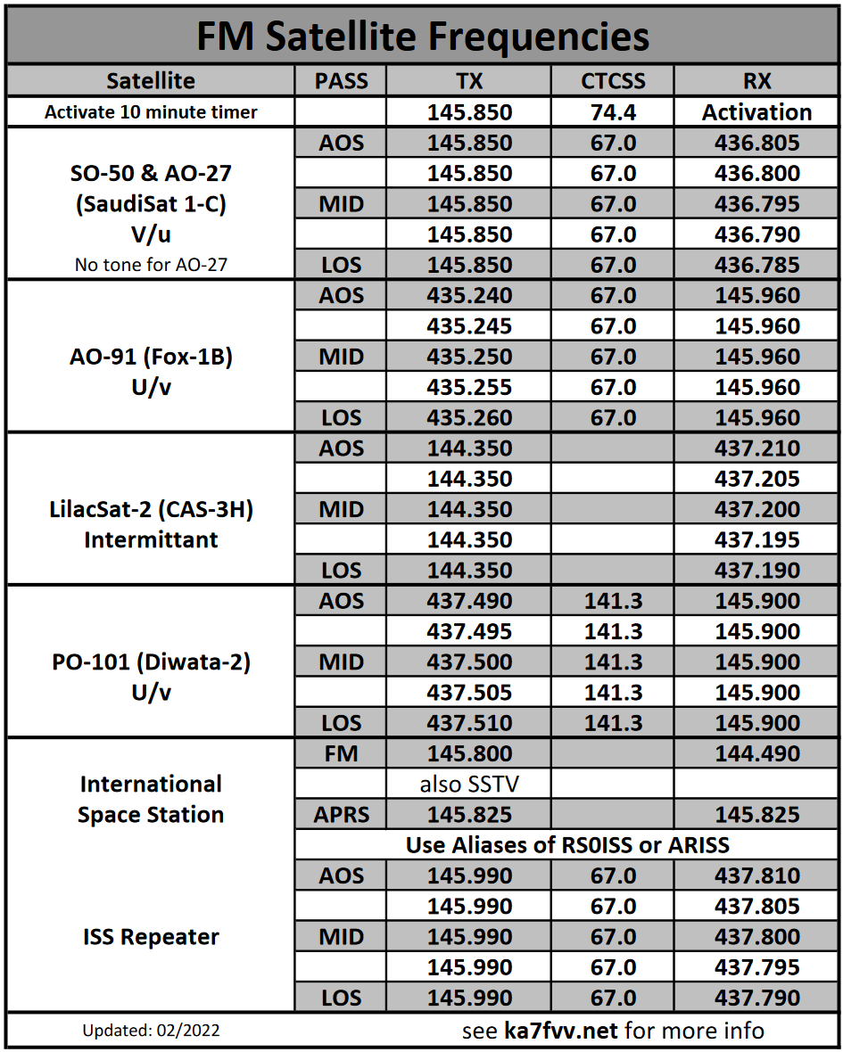
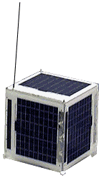
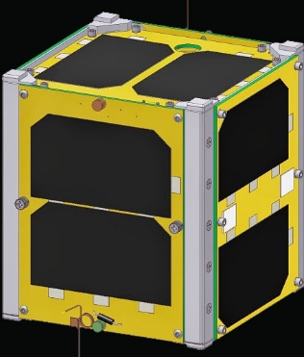
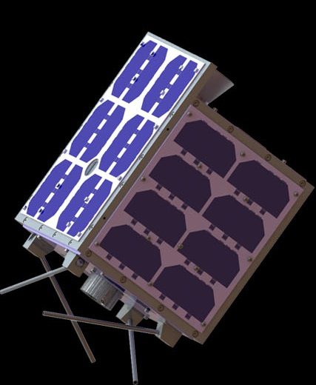
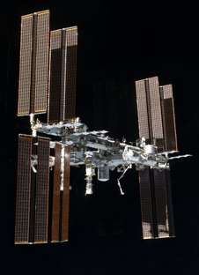
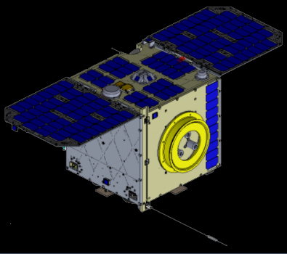
What do I need to work FM satellites?
Satellites Frequencies adjusted for Doppler shift

Slide 9
What do I need to work FM satellites?
Satellite Tracking Programs
Background on tracking programs
Around since the earliest computer. I ran early DOS programs on XT computers and needed to buy a math coprocessor so they would work.
Whether it was the old DOS programs or current Windows, IOS or Android applications all satellite tracking programs need up-to-date keplerian elements to give accurate information. This is a file of data that gives the tracking program a reference point to work from for calculations. Most all tracking programs today have a way to auto update or a place to manually update.
Tracking terms: AOS – Acquisition of Signal (satellite coming above the horizon) TCA – Time of Closed Approach (middle of pass) LOS – Loss of Signal (satellite going below the horizon) Descending Node – going north to south Ascending Node – going south to north Inclination – number of degrees orbit inclined related to the equator

Slide 10
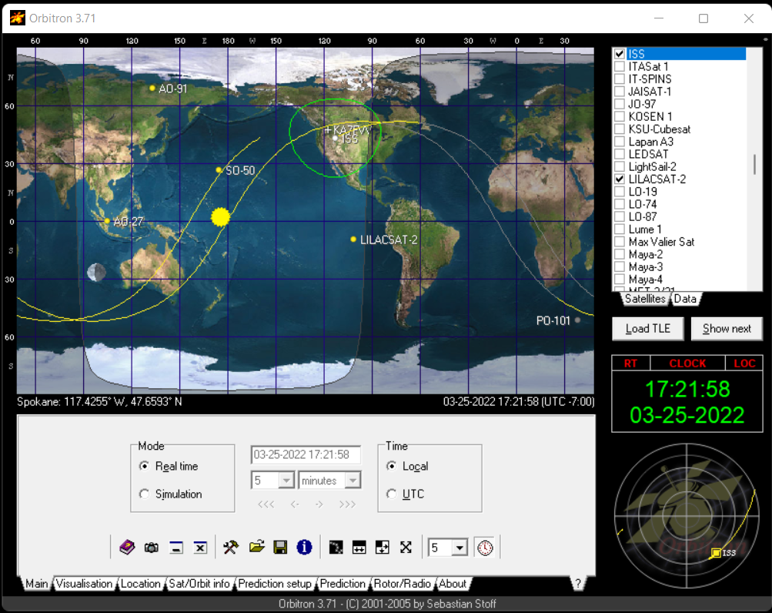
What do I need to work FM satellites?
Satellite Tracking Programs
Orbitron – PC
This is a free program. It has not been
updated in several years but works great.

Slide 11
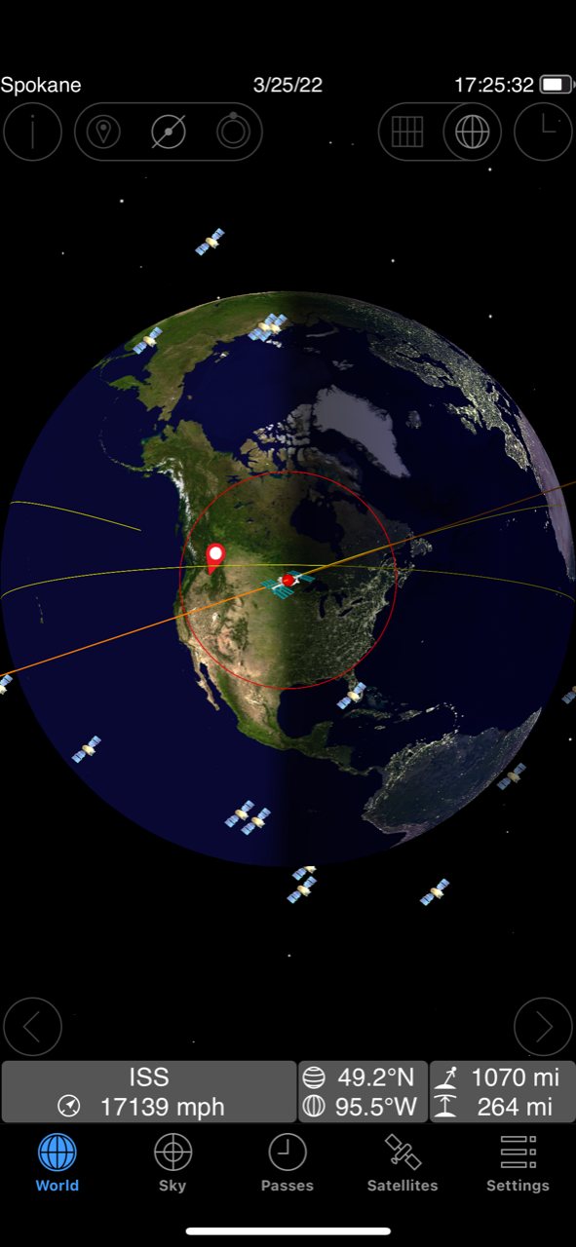
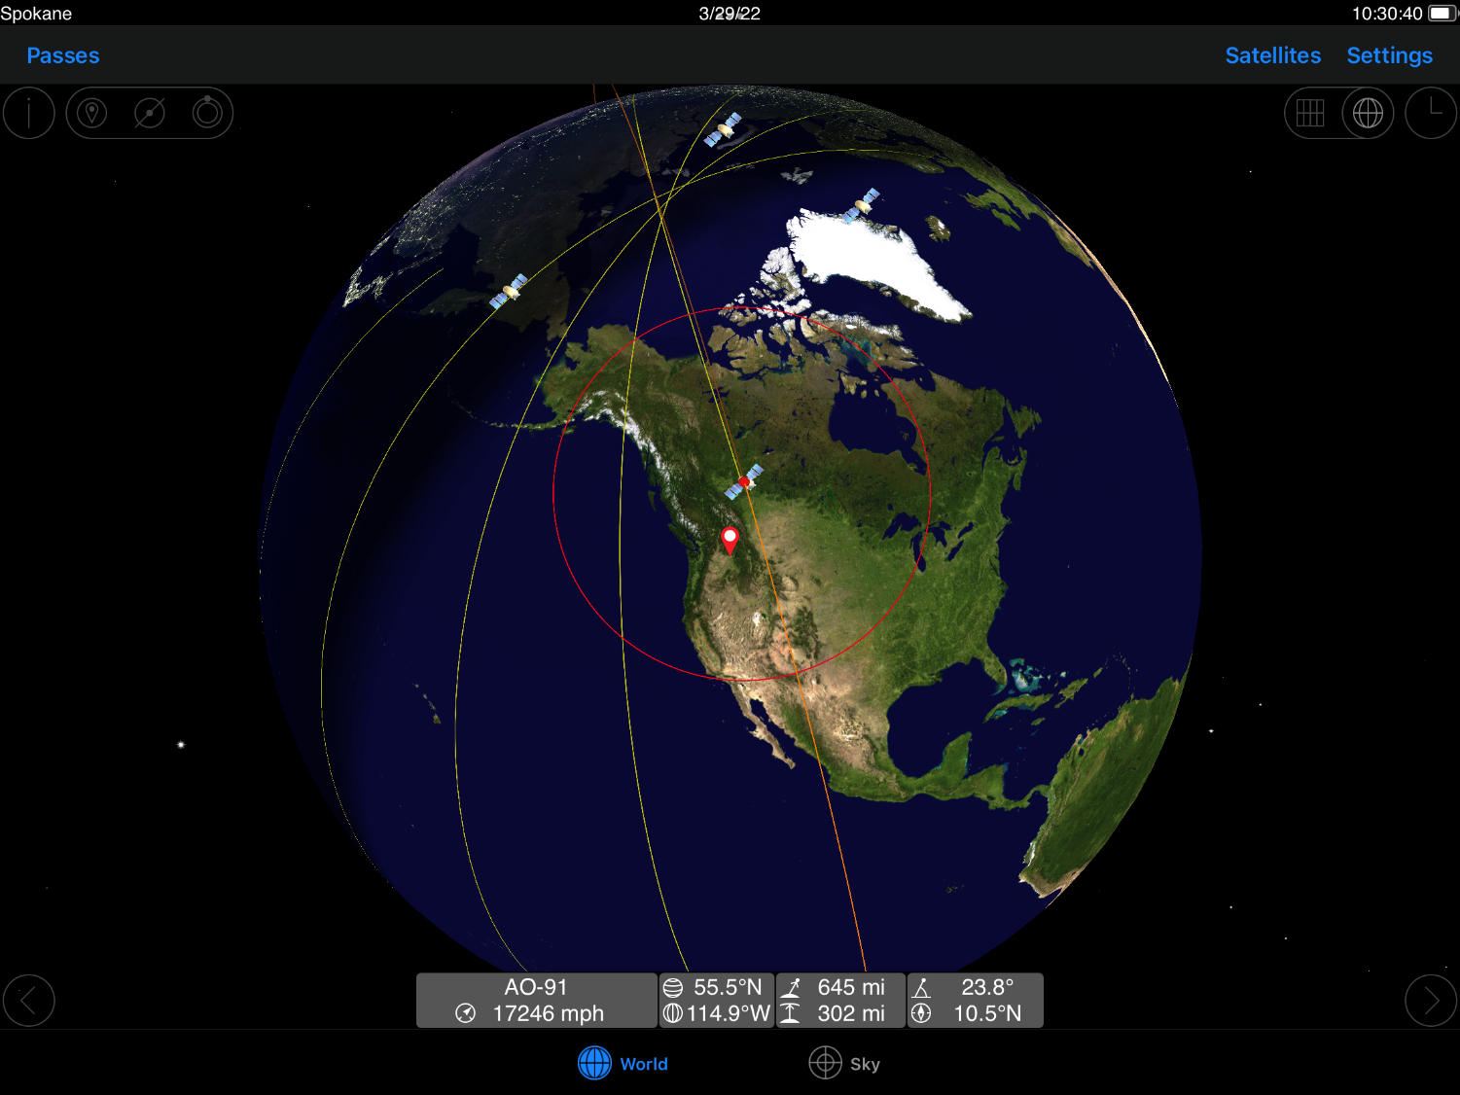
What do I need to work FM satellites?
Satellite Tracking Programs
GoSatWatch and GoISSWatch – IOS $10
GoISSWatch is free and only tracks ISS.

Slide 12
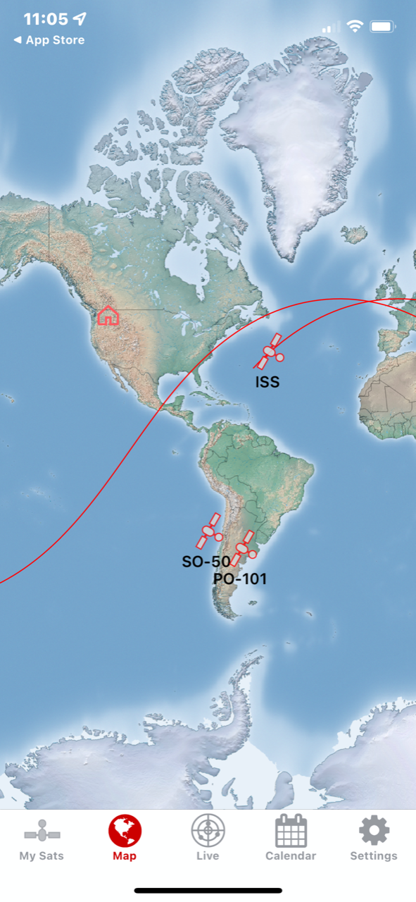
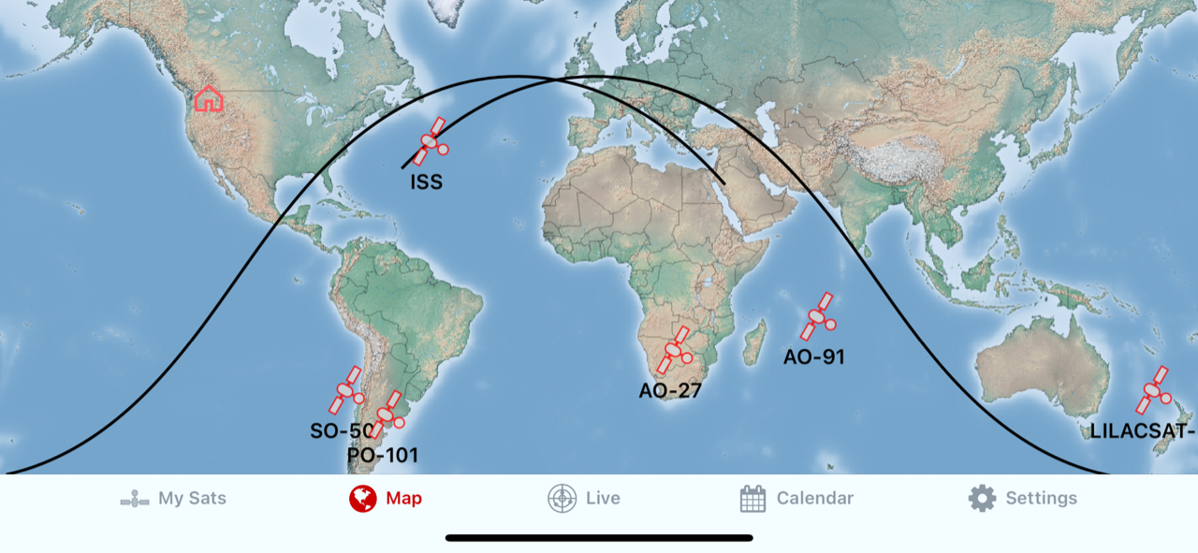
What do I need to work FM satellites?
Satellite Tracking Programs
Sat Sat – IOS – Free

Slide 13
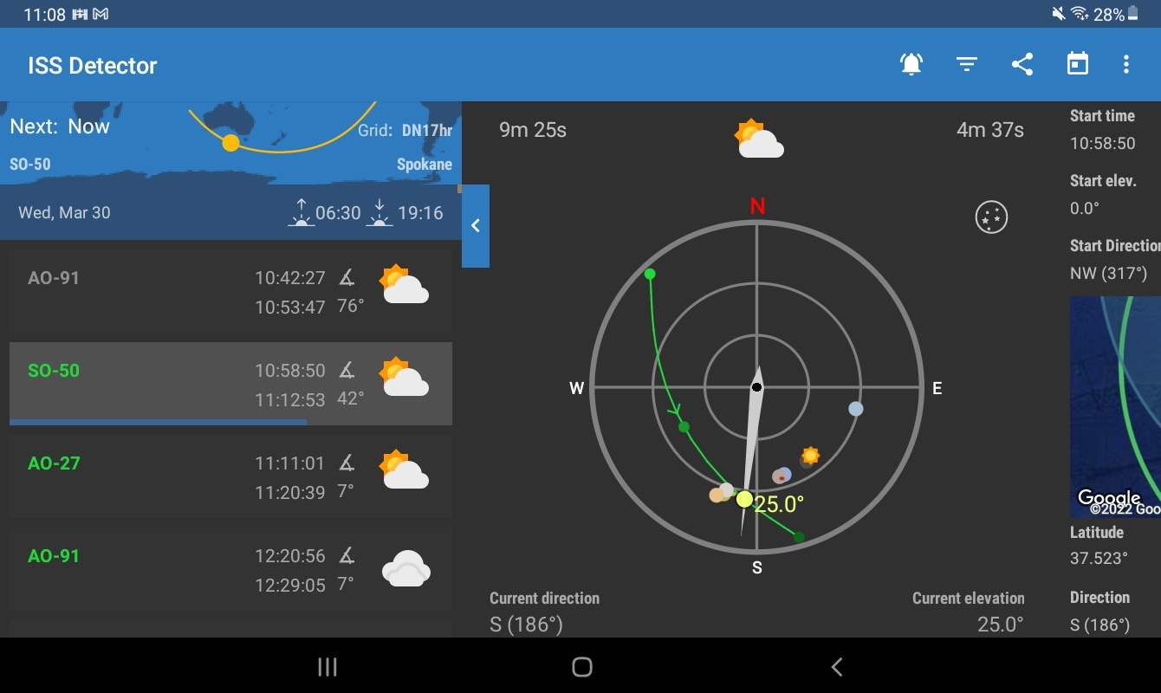
What do I need to work FM satellites?
Satellite Tracking Programs
ISS Detector – Android - Free to track ISS only. The add-on pack must be purchased for $3 to track all satellites.

Slide 14
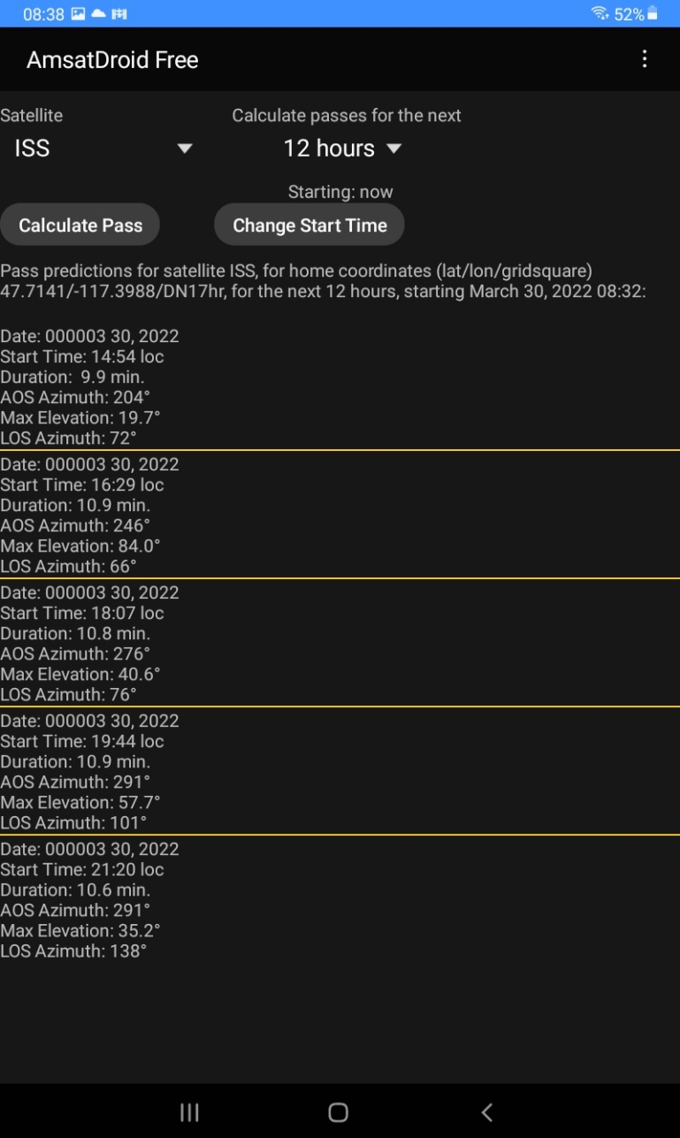
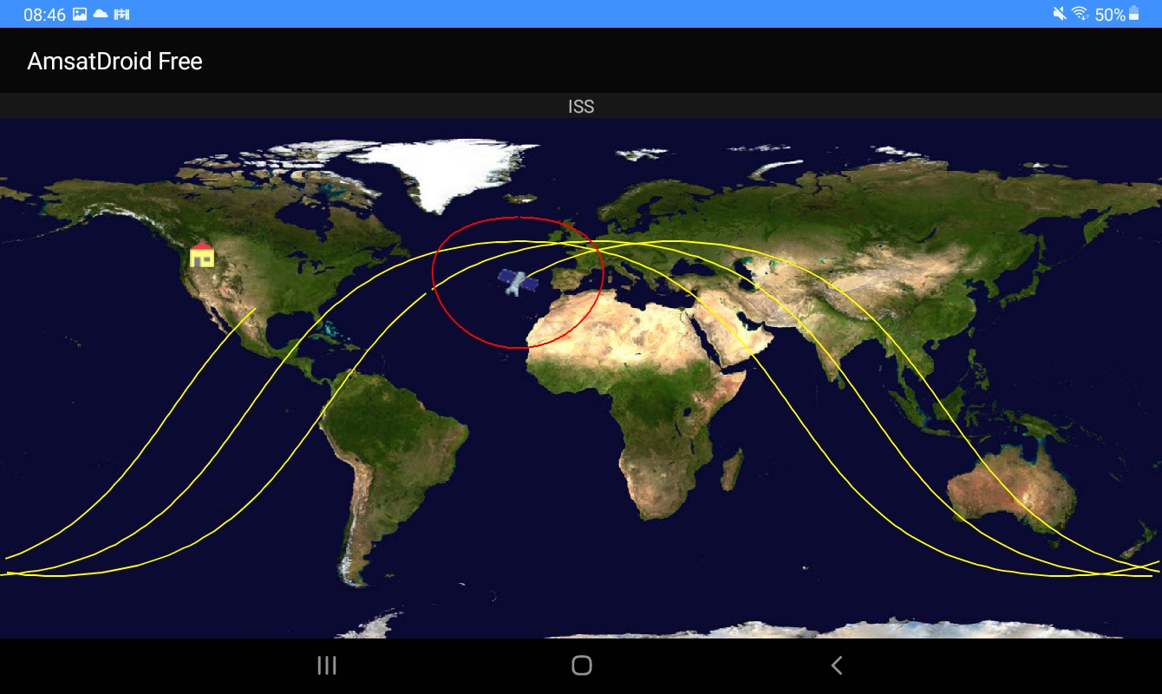
What do I need to work FM satellites?
Satellite Tracking Programs
AMSAT Droid Free – Android (Manually update Keps)

Slide 15
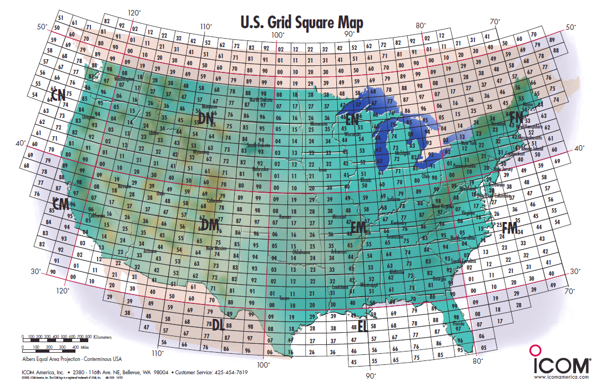
What do I need to work FM satellites?
Making a Contact
Your radio is programmed, you have your antenna ready and you know when one of the satellites will be in range.
Now What?
Making a contact consists of a call sign and grid square exchange. Many stations chase grid squares and get as many as they can. Sometimes you will hear two grid squares where the station is roving and on a grid line. Maybe four as well.
An instrument of the Maidenhead Locator System (named after the town outside London where it was first conceived by a meeting of European VHF managers in 1980), a grid square measures 1° latitude by 2° longitude and measures approximately 70 × 100 miles in the continental US.

Slide 16
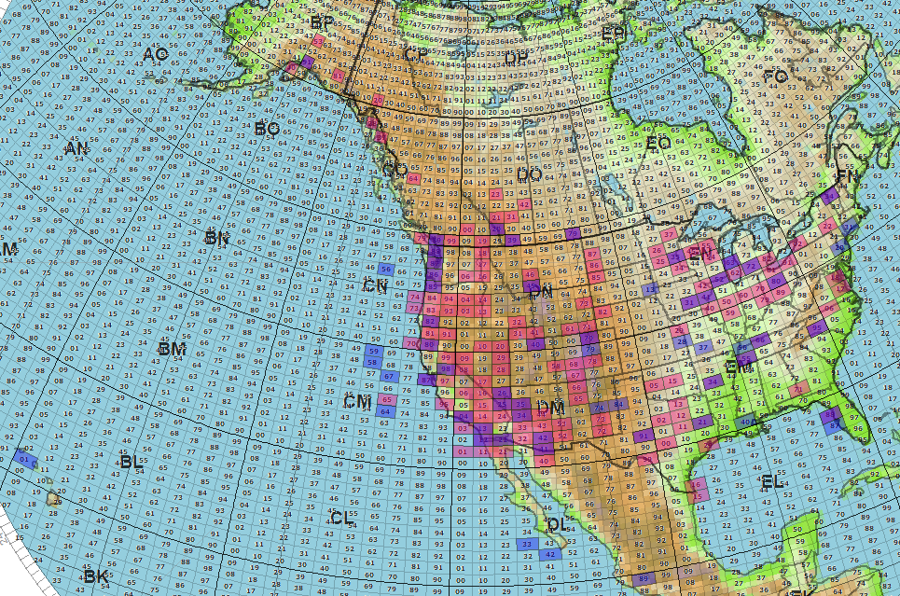
What do I need to work FM satellites?
Red are FM Satellites, the Blue are SSB Satellite, Purple both FM and SSB.

Slide 17
What do I need to work FM satellites?
Making a Contact
First off Listen, Listen, Listen! Make sure you can hear the satellite! Never just transmit hoping for someone to come back to you before you know your equipment is working well. This causes QRM on the satellite if for some reason you are not hearing the satellite, but others do, and are responding to you. The satellite will always here you but you will not always hear the satellite. It never hurts to listen to a few passes to get the feel of how contacts are going and make sure your setup is working properly. AO-91 is one of the busier satellites and contacts go very quickly. If SO-50 is silent you may have to send the tone to turn it on. I always do on descending passes coming from Alaska.
Never call CQ on the satellite. Do QRZ or just simply state your call sign and grid square between contacts or call one of the station you hear.
AO-91 Example pass:

